Slide 1
V. HOW DO I KNOW WHAT IS GOOD OR BAD?
The Moral Conscience

Slide 2
Subtopics
My personal judgement
Particular moral knowledge
Types of conscience
Principles for following one’s conscience
The formation of moral conscience

Slide 3

The moral conscience

Slide 4
Moral Issues
The Case
Outcomes
You forgot your ID card at home.
The Security Guard at the entrance to SU will ask you for it.
What will you do?
  Tell him you are a visitor, not a student?
  Explain the true situation to him?
If you lie to the guard, how will you feel? Why?
What makes you feel like this?
What is conscience?

Slide 5
The moral law indicates a body of truths that should be followed in our human acts.
However, our human acts are always single and specific.
There is a great distance between the universal moral law and specific human acts.
In order to discover the morality of these acts the person must apply the law to each of the acts, keeping in mind the particular circumstances.

Slide 6
Moral Conscience
“An act of the intellect whereby we judge specific acts to be good or bad according to whether they correspond to our final goal or not” (Debeljuh, p. 174).
“A dictate of reason on the goodness or badness of a deed to be done or which has been done” (Mimbi, p. 241).

Slide 7
What is conscience?
The Webster dictionary defines “conscience” as
a) The awareness of the moral goodness or blameworthiness of one's own conduct, intentions, or character together with a feeling of obligation to do right or be good
b) A faculty, power, or principle enjoining good acts the part of the superego in psychoanalysis that transmits commands and admonitions to the ego. The word was taken from Latin, cumscire (with knowledge)

Slide 8
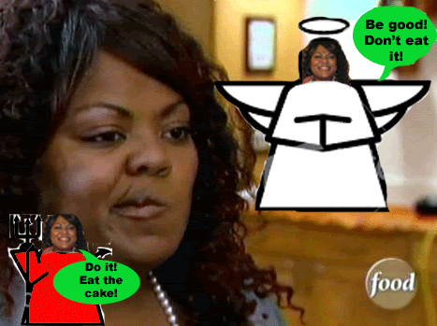
The conscience exists as the mediator between the general law and specific action. We always judge an action to ascertain whether it is right or wrong.

Slide 9
The faculty through which we come to know the morality of our actions is the intellect.
However, the conscience is an act of the intellect whereby we judge specific acts as good or bad according to whether they correspond to our final goal or not.

Slide 10
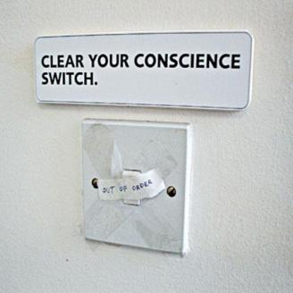
Conscience is the immediate reference point that a person can find for his conduct.
However, the conscience should be true, that is, it should conform to the truth about man and his dignity.

Slide 11
Moral conscience-is a specific judgment about a particular act that is emitted based on the person’s universal moral knowledge .

Slide 12
How moral conscience works
Synderesis formulates the universal proposition :’One ought not to do evil’.
The conscience then analyses whether that specific and particular act, for example, theft, is a bad action.
Then the conclusion will be: ‘This act of theft ought to be avoided’. So the judgment of conscience illuminates the particular and specific action.

Slide 13
Moral conscience & virtue of prudence.
Prudence is the habit that applies the general principles of synderesis, moral knowledge and the practical rules of experience to the particular act, in order to ascertain the moral value of the act.

Slide 14
Once the person, through prudence has discovered the moral value of the specific act,
The act of judgment about whether to do the act or not may be carried out by the conscience.

Slide 15
Elements which intervene in gaining knowledge of the moral value of particular acts
Synderesis and the Natural law supply the general principles. Synderesis establishes that ‘we must do good and avoid evil’.
2)Moral knowledge applies the general principle to a particular type of act: ‘theft should be avoided’.

Slide 16
3) Prudence considers the moral value of a specific act: ‘this is an act of theft’
4) Conscience makes its judgment: ’I ought to avoid this act’
Errors don’t come in at the level of first principles but can come at other levels.

Slide 17
How do these elements come together in working towards a judgement of conscience? Put them in the correct order!
To steal a mobile phone from shop in town
Natural Moral Law
Judgement of
conscience
Synderesis
Particular
moral
knowledge
Prudence

Slide 18
QUALITIES OF CONSCIENCE
Conscience is knowledge
Conscience is practical
Conscience is judgment
Conscience is moral

Slide 19
I. Conscience is knowledge
Conscience is the awareness we have of whatever we are doing. It is the internal knowledge that tells us what we are thinking, what is happening to us, whether we are in control of it or not, and whether it is morally good or not.
Conscience is sensitive; it integrates all the external and internal senses in our perception of things. It gives us knowledge of the outside through the five external senses.

Slide 20
Conscience is sensitive; it integrates all the external and internal senses in our perception of things. It gives us knowledge of the outside through the five external senses.
We are conscious of our identity. We integrate our spiritual knowledge with the sensitive knowledge.
We know that we are different from the external world, and that we can change ourselves and the environment. It is what we call consciousness or state of vigil.

Slide 21
When we speak of conscience as knowledge we are talking about the “hidden eye” that knows what we think, the reasons why we choose to do one thing or another.
It is an eye that is personal and cannot be perceived, or known by any other person, unless we decide to communicate it.
It is also a “permanent eye” that accompanies us always.

Slide 22
II.Conscience is practical
-Conscience acts on the now and here. Our memory is knowledge of the past and our fantasy the imagination of the future.
-Conscience is always knowledge of the present.
- Our conscience is always of a specific place and situation, here and now.
-Our conscience is what keeps us in touch with the real, practical world, our situation here and now

Slide 23
III. Conscience is judgment
Conscience is always accompanied by a judgment.
There is a kind of judgment that automatically makes us react and pulls us away or towards something.

Slide 24
Conscience judges all our conscious actions saying whether they are in accord to our goals or not, and whether they are in accord to our nature or not.

Slide 25
Conscience is always singular, personal and individual.
One cannot properly speak of a "collective" or "social" conscience.

Slide 26
IV. Conscience is moral
Conscience is moral because it is its main function, to help us achieve our end, our perfection, to flourish.
Similarly moral conscience aims at getting the best out of us. It pushes us through our freedom to choose the best for us in each moment.

Slide 27
In order to do this conscience judges, based on the principles of morality inscribed inside us in the synderesis which is like our hardware, our inbuilt makeup as human beings.
With the light of these principles and the knowledge of the moral laws we decide what is good for us in any particular moment, and the habit of doing this repeatedly gives us the virtue of prudence.

Slide 28
Hence because of this, conscience is the first norm of morality.
The judgment of conscience also has an imperative character: man must act in accordance with it.

Slide 29
“Conscience is a “voice’, the “voice of our conscience” which tells us what is good to do, or praises us or reprimands us for what we have done.”
“It is a voice that knows practically and judges morality of each one of our actions. It is a voice that never sleeps,that cannot be kept quiet, silenced. It can, nevertheless, be covered and distorted to some degree.”

Slide 30
Types of Conscience
Timing of Act
Antecedent/
Consequent
Relation to NML
True/
Erroneous
Level of certainty
Sure or certain/
Probable/
Doubtful

Slide 31
Types of moral conscience.
I.How conscience relates to the timing of an act
Antecedent: when one makes a moral judgment before carrying out a free act so as to command or permit an act.
b) Consequent: when a moral judgment is made after an act is done in order to approve of it and enjoy satisfaction, or to condemn the act and experience sorrow or remorse.

Slide 32
II. The judgment of conscience conforms to the moral law if it is:
a) true or right: when the goodness or badness has been judged in a way that conforms to and respects the moral law.
b) erroneous or false: when the moral judgment made by the conscience does not agree with the moral law because it considers a bad act to be good or vice versa. The cause of this error will be some form of ignorance.

Slide 33
III.The type of consent that the person gives to the judgment made by the conscience may be:
sure or certain: the conscience judges firmly that an act is good or bad, without fear of erring.
b) probable: the person does not have complete certainty about the morality of the act.
c) doubtful: fear of making mistake moves the conscience to suspend its judgment on the goodness or badness of an act.

Slide 34
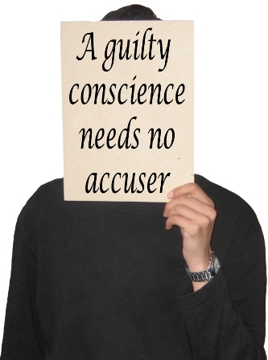
Principles for following one’s conscience.
a) only the sure and certain conscience is a rule of morality that must be followed.
b) The conscience must be true or invincibly erroneous.

Slide 35
c) The conscience that judges erroneously, while being able to overcome that error, is not a legitimate rule of morality.
d) It is illicit to act with a doubtful conscience because one can possibly act badly.

Slide 36
The formation of moral conscience
The human person develops the sense of what is right and what is wrong through the knowledge and formation that he receives from other people.

Slide 37

We therefore need to form our conscience right from when we are very young , when we begin interacting with people in a more personal and conscious way.
From when we are small children we have the seed of conscience (which is a basic sense of right and wrong).

Slide 38
To avoid the dulling of the conscience in the developing human being, it is very important for each person to acquire moral knowledge as they grow.
This basic knowledge of what is right and what is wrong is the necessary basis for the human conscience to work, because its task is not to judge the moral law in itself, but to apply it in particular cases.

Slide 39
Educating our conscience goes hand-in hand with growing knowledge of the truth: if the intellect can get to know the truth more and more, and better and better, then the moral judgments that a person makes can become ever more right, better, truer.

Slide 40
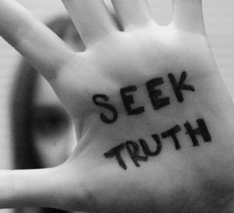
Love for the truth, the desire to know the real truth, is an important starting point, for the development and activity of the human conscience and so for determining the morality of our free acts.
This formation of the conscience in the truth requires effort.

Slide 41
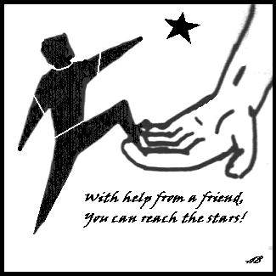
We need to make an effort to acquire the necessary moral knowledge in order to be able to apply these ethical principles to our acts.
Specific things we need in order to form our conscience and we cannot leave it to common sense or good will. For example:
a) to study
b) to read
c) to learn from experience of others
d) seeking advice
e)Training in virtues

